Slide 1

Tata Treats
Training Deck
The information contained in the document is proprietary to Tata Industries Limited- Tata Insights & Quants Division and is strictly confidential. In consideration of receipt of this document, the recipient agrees that the information is being shared only for the limited purpose. The recipient of this information further agrees to maintain such information in confidence and to not reproduce, disclose, duplicate, electronically transmit or use in whole or in part for any other purpose. Prior written consent shall be obtained from the Insights & Quants Division of Tata Industries in case the information is necessitated to be shared with anyone other than the Recipient to whom this information is addressed. The above restriction shall not limit the right to use the information contained in this deck, if it is obtained from another source without restriction. © Copyright, Tata Insights & Quants Division, Tata Industries Limited

Slide 2


AGENDA
1
About Tata iQ
2
About Tata Treats
3
Partner On-boarding
4
Product Design
5
Member Acquisition Plan
6
Technology
7
Business Model
8
Annexure

Slide 3
01
ABOUT TATA IQ

Slide 4



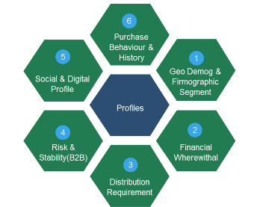

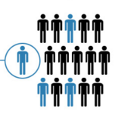


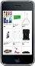









Tata iQ Charter and Offerings
Insights
Richest and Most Valuable Database
Collaboration and One Tata
Campaigns
Customer Insight &
Prospecting
Proprietary
Offline
Data
ShopsAPP
Risk Analytics
Public
Affiliate
Marketing
Online
Data
TSSS’15
Supply Chain
Operations
Group-wide Loyalty
Internal
Advanced Analytic Solutions
Tata iQ Proprietary Database
Building One Tata
Profiling, Segmentation, Predictive Analytics, Machine Learning
Quantitative Analytics, Existing Customer management (cross-sell, up-sell), Pricing, Channel, Store, Online, Assortment, Risk, Digital, Operations, Prospecting
900MM People Base
300 MM Enriched Base
Data across Individuals & Institutions
Unified customer view, Maximize Revenue
Minimize Expenses,
Encompassing Loyalty mitigate risks, superior customer experience, sales/revenue growth

Slide 5
02
ABOUT LOYALTY AND
TATA TREATS

Slide 6













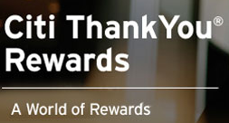




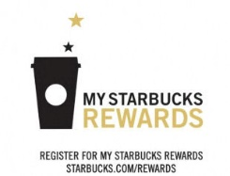







About Loyalty Programs
Kinds of Programs
Global Programs
Indian Programs
Airlines
Hotels
Credit Cards
Retail
Enterprise Loyalty
Coalition Loyalty

Slide 7

Vision: Best Loyalty Program in India with a member base of 1 Billion
DATABASE
OUTCOMES
Tata
iQ
Tata
Group
Individual
Tata Company
Delight Customers through Recognition
Sell more of same product to customer
Cross sell our products to our customers
Reactivate ‘Inactive’ Customers
Recognize customer’s Loyalty to Tata Group
Cross sell to other Tata Company customers
View of
individual gets
Broader,
Deeper
& Richer
Prospect to non Tata customers
Improve response rates to all of the above

Slide 8










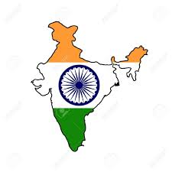
Coalition Loyalty has been driving Business Benefits successfully
World’s leading Coalition Programs
Use Cases*
NECTAR (UK)
PAYBACK (India)
Nectar cards Christmas shopping £100 MM worth of points redeemed- Sainsbury
Central : additional
~30Cr sales in EOSS in 2014
Debenhams Nectar customers spent significantly more than non-Nectar customers
ICICI: 20K new cards, 3K personal loans, loan value of ₹ 75 Crores
PLENTI (USA)
Big Bazaar: 60% lapse rate reduced to 42%, with Festive Incremental ₹ 94 Crore sale
Macy’s: more than 2 million customers enrolled in the first week
* Payback India

Slide 9
Industry Landscape
Benchmark: Best in Class Coalition Loyalty Programs
From traditional/generic programs
To contemporary coalition programs
Multiple loyalty cards and identifiers across various loyalty programs- difficulty to keep track
Lower earning within a single spending category
Limited redemption options/rewards inventory
Higher threshold of redemption- minimum point accumulation slabs
Ability to redeem via limited channels/media
Rewards on Purchase
Points Expiry
Rewards Only
Single identifier across multiple companies/partners- easy wallet space and recall
Accelerated earning across multiple spending categories
Redemptions across multiple spending categories- broad and rich range
Ability to do leverage Instant Redemptions
Ability to redeem via numerous channels/points of interaction- E.g. Payback
Rewards on Engagement- E.g. Starbucks
No Points Expiry – For active Members- E.g. Amex
Rewards + Experience- E.g. Marriott

Slide 10
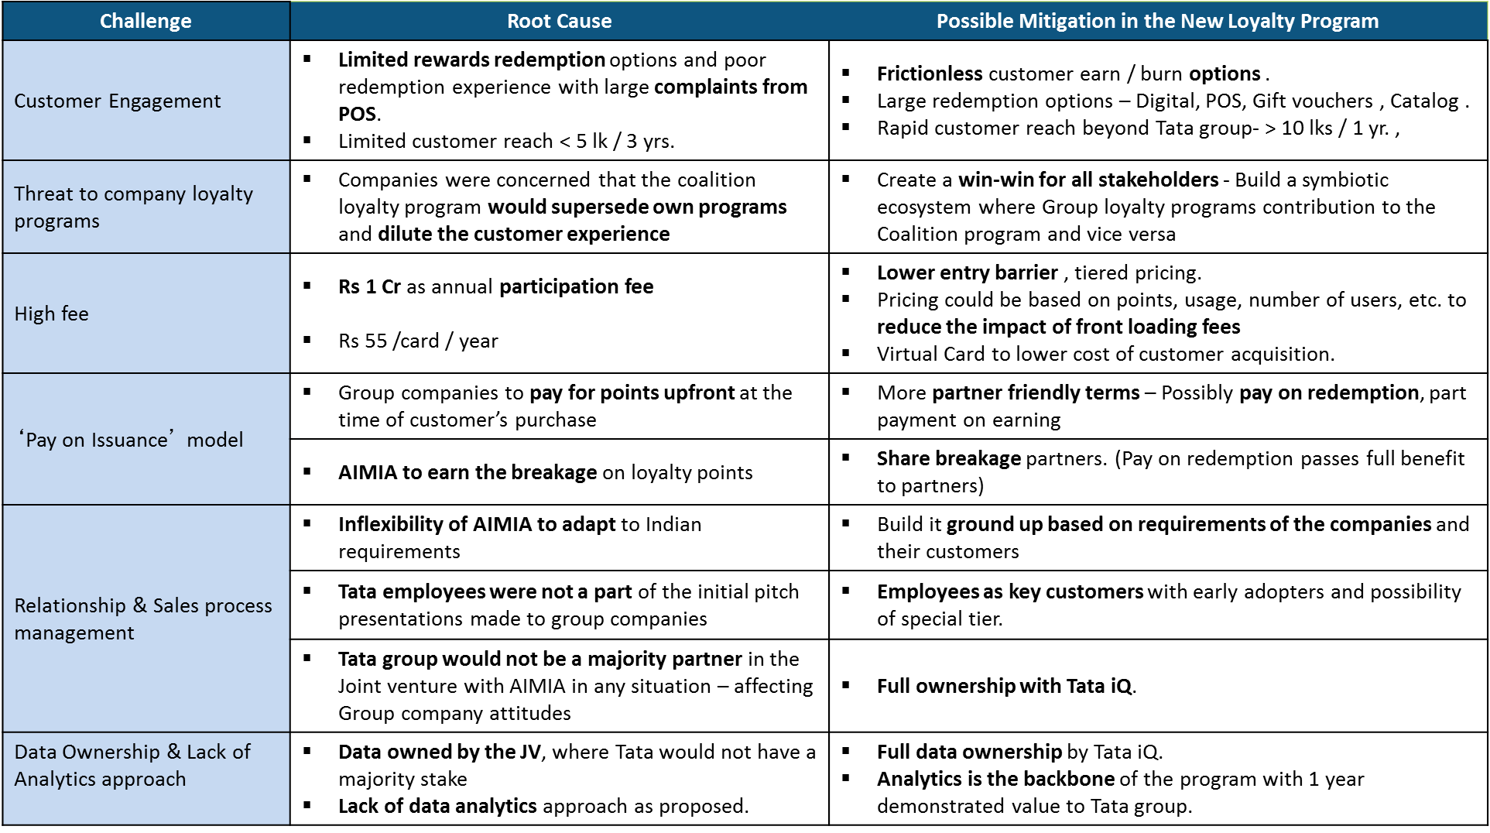
Learning from Empower and Tata cards What is different now ?

Slide 11
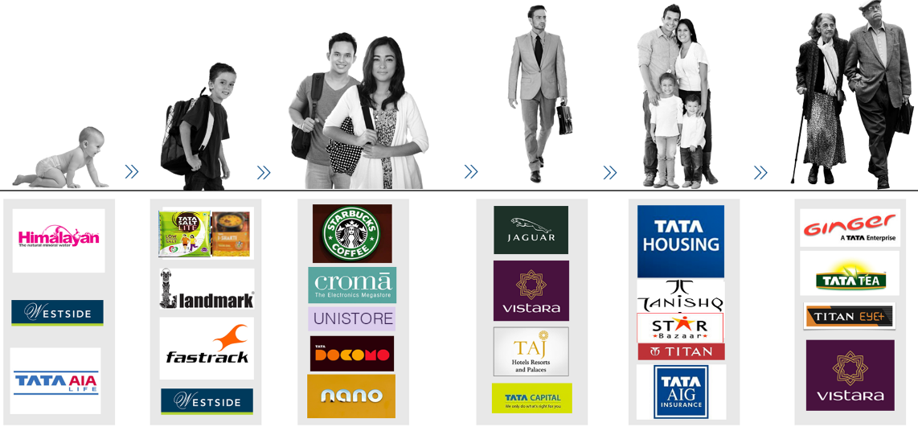

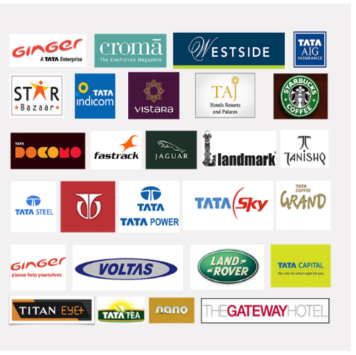
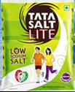
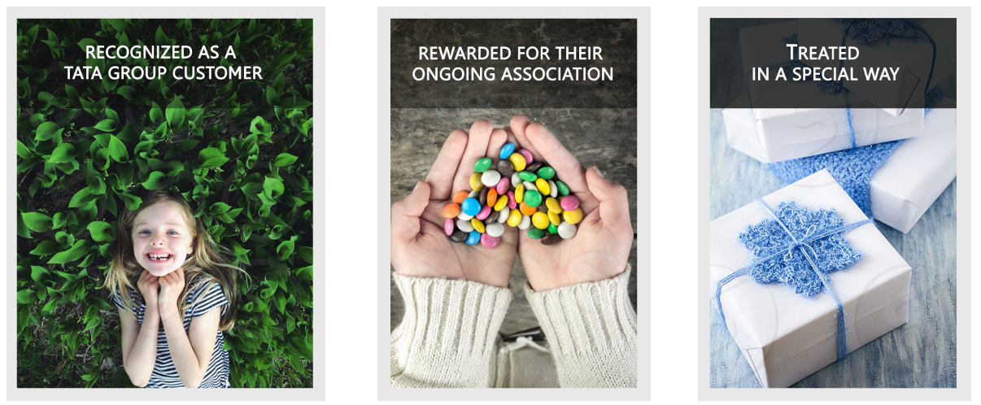
A lifetime of relationship with customers …now recognized
We touch a customer throughout their lifetime
Won’t it be great if our Customers could be…
… an exclusive rewards program

Slide 12







Member Value proposition
an exclusive rewards program
Program Benefits
Special Privileges
Pride of association
Earn Redeem
Accelerated points earning across various categories and brands
One card across Tata Group: Multiple Redemptions across spending categories - broad and rich range
Instant Redemption via numerous channels /interaction
Anytime Anywhere: Card-less program for enrolment/transactions
Real-time personalized offer/ coupons – bundled offers
Earn point without buying - Social media engagement, brand advocates
Sweepstakes, unique and special treats from Tata Group
Shopping happiness with Tata –
Select ideas:
Shopping Valet, Splurge budget for Westside/Croma/Star Bazar
Starbucks - name a drink contest
Indulge with Taj hotels - Breakfast / Lunch at the Taj, Check in at a high category room
Tanishq Custom jewellery
Join Tata in it sustainability initiatives Volunteer in Tata social Engagement drives, donate points worth benefits for social causes.
See how Tata products are created Guided tour of Tata Motors / Tanishq / JLR Plant,
Experience and participate Visit Coffee plantation visit and tasting, Tea tasting session

Slide 13







Why Join Tata Treats…
Faster Customer acquisition - Tata affinity
Win-back Inactive Customers
Increase Customer Stickiness
Enriched Customer
profile
Increase Personalization and Marketing ROI
Savings in infrastructure, People, Backend, Tech*
Robust Processes and Loyalty Platform
Proprietary Consumer data & Advanced analytics
Stringent Data security and Governance
Higher Customer engagement, Greater Stickiness, and Increased Wallet Share
* Companies not having a loyalty program.

Slide 14
What is different now…
Compared with other coalition programs and learning from Empower & Tata Card
PROGRAM
PARTNERS
Run by Tata iQ; no dependencies on external agencies like AIMIA, GE-SBI.
Partners can run their own program.
Secured data standards with Robust, Scalable, and Nimble Technology
No (upfront) Participation Fee in 1st year Partners to retain breakage.
Governance around customer Communication (Payback contact every 4 hours) and Privacy
Flexibility to decide point Earn rates
(with uniform point rate of Rs. 1)
Large and unique aspirational redemption & treats catalogue
Easy to enter, Easy to exit. Driven by performance – no hidden clause.
Mutually exclusive companies yet large width to earn & redeem points.
Tata Treats Gift Card- A strong TOOL to initiate employees & partners into Tata products.
Drive by Tata iQ to acquire members;
1 million members in 1st yr.
Analytics is the backbone of the program supported by 50+ Tata iQ strong team.

Slide 15








Multiple options to engage and enrol with Tata Treats
1
Full Earn - Burn Partner
2
3
Exchange Partner
Double Dipping Partner
Join Tata Treat as Full Earn – Burn partner
Continue running existing loyalty program with a loyalty exchange with Tata Treats
Continue running existing loyalty program with an option to award Tata Treats points to Consumers / Employees / Partners
GO-LIVE in 8 weeks
Our First Anchor Partner

Slide 16
03
PARTNER
ONBOARDING

Slide 17




P
Partnership –Discussion Charter
July
Initial discussions held with Titan, IHCL, Ginger, Croma, Tata Capital, Tata Motors, Tata Housing
Positive response from all partners
Unistore: Finalization of earn rate and commercial model underway
Plan to have Phase 2 Partner consent on Commercials completed by August last week, parallel initiate technology integration
May - June
Aug
Full Partner
Tata CliQ
Croma
Ginger
Tata Capital
Tata Housing
Tata Motors
Tata Power
Westside
Starbucks
Star bazaar
Vistara
Exchange Partner
Titan
IHCL
Tata Steel
Tata Chemicals
TGBL
Tata Steel
TCS
Corporate Buyout
Targeted Phase 2 Partners

Slide 18
04
PRODUCT
DESIGN

Slide 19




Program Features
Being a part of Tata Treats Program, the member will have a chance to go beyond points and earn special experiences and privileges
Low
SOCIAL CAUSES
Members have the option and opportunity to contribute towards their chosen social cause and track it to fruitition
EXPERIENCES AND EVENTS
Experiences are non-tangible benefits, meant to provide once in a lifetime opportunity to exclusive members. These are highly Tata Centric and create sustainable competitive advantage
Member Volume
GOODIES
Goodies are tangible benefits awarded to the member which are highly personalized and add value to the member’s desires
POINTS AND DISCOUNTS
Points are earned through transactions made with the Partner Network and by actively engaging with the Tata Treats Program
High
Best
Upcoming
Member Quality

Slide 20
Privilege Prioritization
A privilege is prioritized by it’s Cost X Perceived Value X Implementation Probability
Privilege Categories
Associated Cost
Perceived Value
Implementation Probability
Plant Visit
Experiences
Events
Goodies
Pride of Association
The cost of the privilege is defined as the cost to the company/loyalty program to fulfil the privilege for the member. It is inclusive of all elements of the privilege
The perceived value of the privilege is the association that a member holds in the mind of the brand/opportunity irrespective of its actual value
Implementation probability is the degree of confidence that the privilege can be rolled out in year 1 of the Tata Treats Program
The Cost and Perceived Value determine the tier of the Privilege- higher the Cost and Perceived Value, more exclusive the Privilege is
Implementation Probability determines the timeline when the Privilege can be rolled out as part of the Tata Treats Program- higher the probability, earlier the Privilege can be rolled out
Illustrative Example
Plant Visits (Company) | Location | Frequency/ Year | Batch Size | Cost/ person | Total Cost | Perceived Value | Implementation Probability
Titan | Hosur and Dun | 4 | 10 | 30,000 | 12,00,000 | Medium | High

Slide 21
Roll out Plan of Privileges
Each wave will have Privileges of all Tiers but in different proportions. The waves are ascertained by Implementation Probability and Eligibility
Millions
High
Current Position
2
Wave 2:
Customer Launch
Engagement Level
Wave 1:
Employee Launch
Member Volumes
Medium
1
Lakhs
3
Wave 3: Full Throttle
Low
Thousands
1st September
1st November
1st January’17
1st March’17
31st August’17
Wave 1: Employee Launch
Wave 2: Customer Launch
Wave 3: Full Throttle
High number of Tier 1 Privileges- As members earn more and move up the ladder, they become eligible for the best
Wide range of privileges with High Perceived and Actual Value
Start with a range of privileges moderate in value yet aspirational
Limited no Tier 1 Privileges and minimal tier 3 Privileges
Provide these privileges across a wide audience to create buzz
Roll out Privileges of higher quality and value. Limit the number, do a few to create customer voice.
Hold back the top tier Privileges till the time sufficient number of customer show value,

Slide 22
Roll out strategy of Privileges
Timeline
Sept’16 to Oct’16 |  | Nov’16 to Feb’17 |  | Mar’17 to Aug’17
Total Privileges: 9 |  | Total Privileges: 3288 |  | Total Privileges: 5316
 |  |  |  | Societal Causes: 7
 |  | Societal Causes: 5 |  | Tata Properties+ Experiential Benefits 36
 |  | Tata Properties+ Experiential Benefits 25
Societal Cause: 1 |  |  |  | Goodies: 6172
Tata Properties+ Experiential Benefits 8 |  | Goodies: 3661
Goodies*: 0
Break up
Of
Privileges
Members Touched
45
3751
6302
Privileges Cost
3 Lakhs
37 Lakhs
60 Lakhs
We estimate to touch 10,000 (2-3/day) of 1MM members with the Tata Treats Privileges in Year 1 at a cost of INR 1 Crore
Goodies*: A separate budget will be used as part of referral program, estimated to be ~40 Lakhs

Slide 23
Member Engagement: Go to Market Privileges
 | Company | Privilege
Societal Causes | Tata Trusts | Week long stay in a village
 | Tata Sustainability Group | Participation in events
 | Tata Treats/Tata Trusts | Donate Points to listed NGO/Social Cause
Tata Properties | Tata Steel | Jamshedpur Plant OR Kalinganagar Plant OR Iron Ore OR Coal Mines (Noamundi, West Bokaro)
 | Titan | Watches and Jewellery Plant, Hosur and Dehradun
 | Tata Motors | Pune OR Jamshedpur OR Uttrakhand OR JLR Assembly (Pune)
 | TGBL | Bangalore Factory OR Tea Plantations- Munnar and Assam OR Coffee Plantations in Coorg
 | Tata Chemicals | Mithapur and Dwarka Visit
 | Tata Power | Hydroelectric Units
 | IHCL | Taj Mahal Palace, Heritage Walk
 | TMTC | Tata Archives
 | Company | Privilege
Experiential Benefits | Starbucks | Coffee Tasting at Starbucks outlets
 | Tata Motors | Prima Lounge OR Vehicle Launch Invite OR Experience Drive OR Narayan Karthikeyan Meet
 | JLR | Vehicle Launches, Experience Drives
 | Tata Steel | Tata Steel Adventure Foundation Trek
 | Vistara | Pick n Drop/Free Upgrade
 | Tata Sons | NCPA Plays- Tata Lit Fest
 | IHCL | Day at Presidential Suite/Dinner for 2
Goodies | Tata Sons | JRD Coins/Other Memoribilia
 | Unistore | Surprise Gift from Unistore- Home Delivered
 | Croma | Discount Voucher
 | Titan | Discount Voucher
 | IHCL | Taj Dinner for two
 | Starbucks | Coffee Vouchers for two
 | Tata Communication | F1 Merchandise
Contd…

Slide 24
05
MEMBER ACQUISITION
PLAN
Confidential Property of Tata Industries Ltd – Tata Insights & Quants Division

Slide 25
Phased Acquisition Plan
Phase 1 – Pre launch – Sept’16– Oct’16
Phase 2 – Launch – Nov’16
- Jan 17
Phase 3 – Strengthening Tata Treats
Jan’17 – Aug’17
OBJECTIVE
Tease employee with privileges & offers as “Treats” by the Tata Group, with minimal brand / program exposure outside group.
Tata Treats is officially launched with the platform – ‘Better Together’ for end customers to acquire members
Engage consumers with various activations centered on thanking their friends, family or society at large
SEGMENT
Employees
(Working Women, Young professional, Millennials, Executives)
Employee F&F,
Channel Partners
Store Walk-ins / Online Visitors
Phase I Segment + Working Women, HNI, Executives
Phase I & II Segment + House wives + Greying, Professionals.
CHANNEL
Office premises, digital assets, e-mails, Tata World
In-store activity
Digital & Partner websites
Multi touchpoints
Digital / Radio / Instore activity
KEY ACTIONS
Presence across group offices
Reach out to our employee base via e-mails & Digital Assets (Intranet)
Privileges as a key hook
Referral & Rewards Program
Launching Better Together across
Fun activations across partner stores
Re-marketing online people who have shown an interest in any Tata Group
Social Presence & PR
Contests
Referrals
Shopping gamification - Tata Shopping League
Est. Enrollment
200,000
600,000*
1000,000*
*Estimated Enrolments- Actuals to be determined

Slide 26
Launch Considerations
PROGRAM CONSTRAINTS
Partners
Only Tata CliQ as a partner in the launch phase.
Remaining partners to join in during the customer launch
Redemption
Redemption and exchange of points not activated immediately
Members can only accrue points
Reach
Direct reach to only Group Company employees via office spaces and digital channels
Current Approach: Soft Launch
Alternate Approach: Full Launch
USP of Tata Treats is the reward and benefit offered beyond point accumulation and redemption
Under the listed constraints, Privileges will be key to drive aspiration
Member get member will serve as the primary marketing drive
On-board 5 partners with earning, redemption and exchange
Reach out to the entire base as opposed to only employees
Drive enrolments with multiple levers- Program Proposition, Privileges and Rewards, Referrals
THANK YOU & PRIVILEGES AS THE KEY VALUE PROPOSITION,
EARN – BURN ACROSS MULTIPLE PARTNERS AS THE KEY VALUE PROPOSITION.
Notes:
No soft launch

Slide 27







Employee Launch Strategy
Target Group: Employees- Working Women, Millennials, Young Professionals and Executives; Employee F&F; Vendors
Communication Strategy
Companies of Focus
Better Together Platform
Sr. No | Company | No. of Employees
1 | Tata Consultancy Services | 274265
2 | Tata Steel | 35439
3 | Tata Motors | 26375
4 | Tata Business Support Services | 21216
5 | IHCL | 16187
6 | Tata Communications | 16099
7 | Tata Coffee | 8593
8 | Titan | 7843
Why Tata Treats ?
Emotional Connect
Driving Enrolments
CHRO’s serve as the primary means of reaching out to companies
Channels
Tata World Website and Mailing List
Tata Treats Website
Company Digital Assets (Intranet)
Standees/ Brochures
INCENTIVE: PRIVILEGES AS THE KEY LEVER TO DRIVE ENROLMENTS

Slide 28
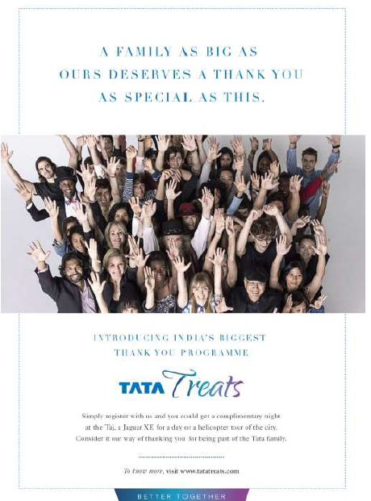



Launch Film/Video
Thank You Campaign
Better Together Film

Slide 29


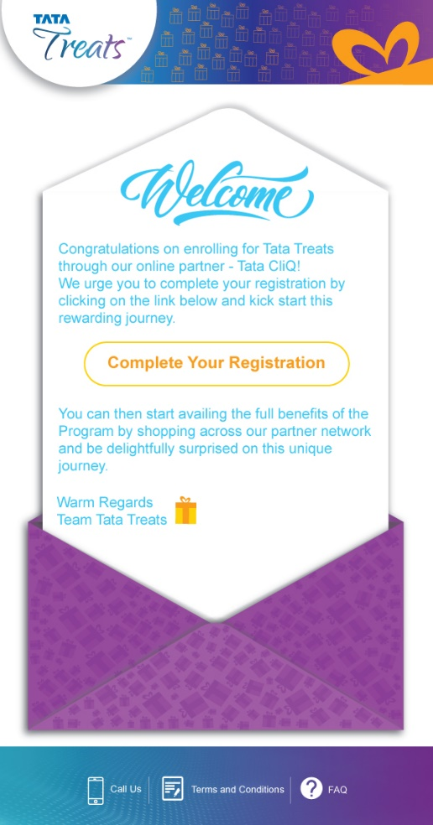
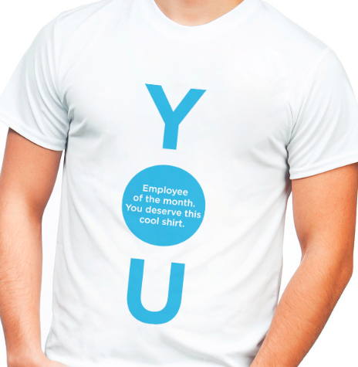
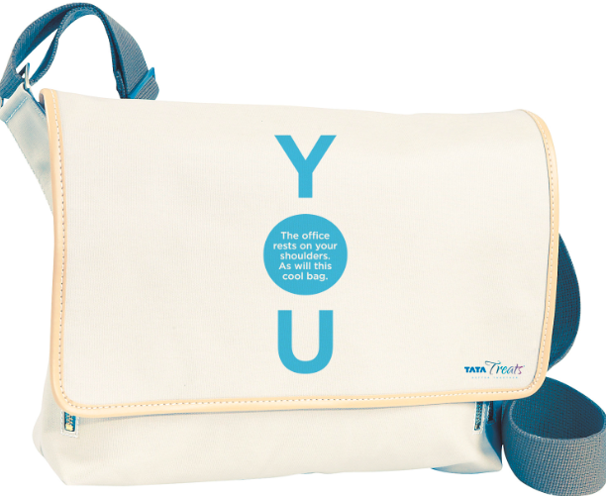
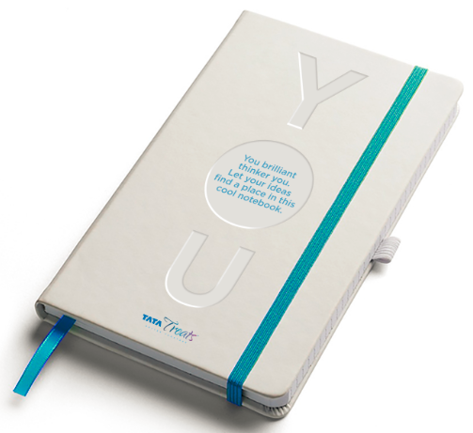



Emotional Connect: Employee Launch Communication
Illustration based
Real imagery based
WELCOME EMAILER
MERCHANDIZE

Slide 30
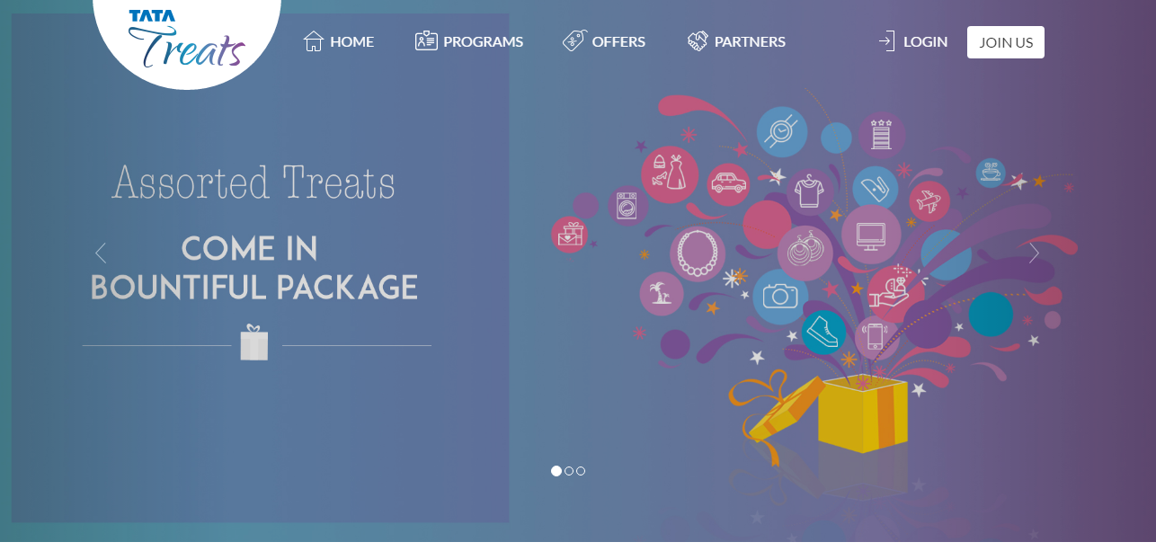
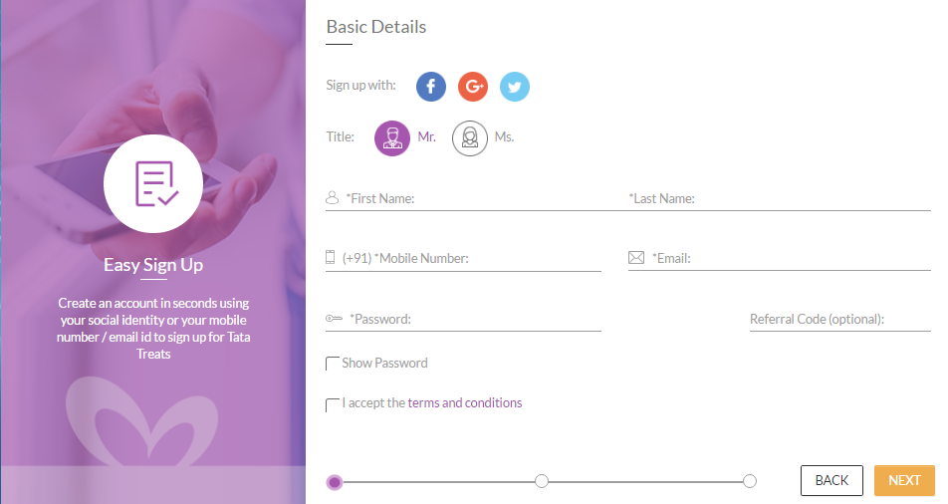
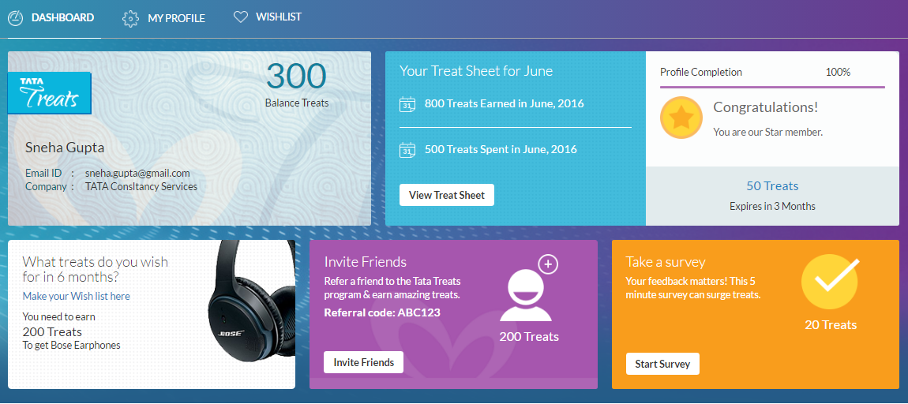
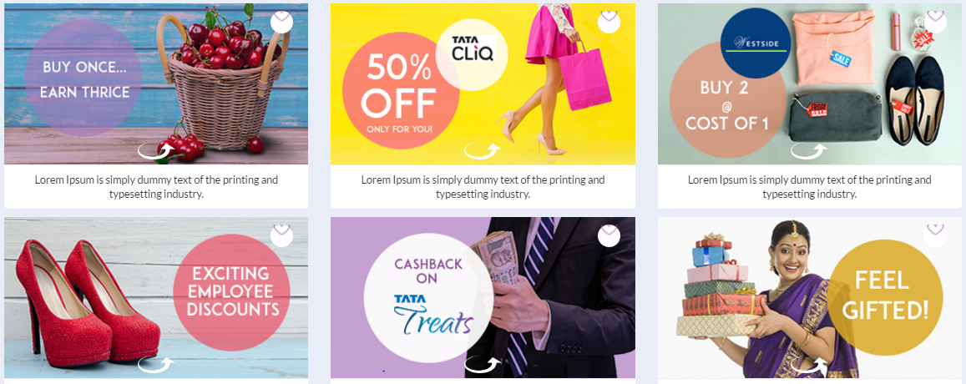
Website Demo
Tata Treats Website Demo Link

Slide 31
Driving Enrolments: Referral Program Design
Referral Design
Single Sided Incentive
Only the Referrer gets the reward upon successful referral. The Referee is not awarded incentive to sign up
Take: Impacts Invite to Sign-up ratio but keeps the budgets in check
Referral Incentive
Slab Based Rewarding
The incentive is given upon achievement of certain goals and milestones. E.g.- Taj Stay upon completion of 100 successful referrals.
Take: Beneficial for Power Users who want to strive for higher benefits and refer regularly
Referral Structure
Starbucks Coffee
Free flight upgrade, Exclusive merchandize
Nano
Top
Referrer
Rewards
Jewellery Set
0
1
5
10
25
50
Sponsored Holiday
50 points
Titan/Unistore Voucher
Chef’s special dinner for 2 at Taj
Referral Leader Board
Estimated Conversions
The approx. cost of the referral program along with rewards is INR 40 Lakhs
Invites: 2,30,000
Conversions: 92,000
Cost/Acq.: ~INR. 43
Costs to taper down in subsequent phases

Slide 32
Tata Treats – Phase I Acquisition Execution Plan
Timelines
July’16 | 5-Aug-2016 | 12-Aug-2016 | 19-Aug-2016 | 26-Aug-2016 | 2-Sep-2016
1
Planning
Finalize Strategy and execution plan
Finalize creatives
2
Initiating Discussions to Leverage Group Assets (Tataworld, GCC)
Setting the Stage
Discussion with Group HR
Discussions with Key Target Companies on Partnering for Acquisition and Rewards
Finalize the Company assets which could be leveraged for the Campaign
3
Test run the campaign (along with Group and company assets)
Execution
Finalize member registration and referral flow and develop the microsite for Referrals
Started
To be Initiated
Next Key Milestones
Launch Campaign
Critical Success factors
Proactive support from Group companies to help leverage their digital / physical assets
Timely completion of the overall acquisition strategy

Slide 33



Tata Treats – Phase I Launch 1st September’16
Launch Partner
Technology Readiness
CliQ Customers Auto enroll in to Tata Treats
Earn points at Tata CliQ
Co-marketing between Tata CliQ and Tata Treats
No Redemption options at launch (interim plan to enable redemption in CliQCash)
On-board partners
Earn & Burn
Liability Reporting
Basic Analytics
Member Registration
Referral microsite
Member Account page
Partner Offer page
Customer Service
Campaign launch to enroll Tata Ecosystem
Member Rewards and Privileges
“Better together” brand platform
Referral scheme to enroll Employees, Channel partners and Friends & Families
Leverage group digital assets
Presence across Group company digital and physical
Experiences from Titan, TGBL, Tata Chemicals, IHCL and Tata Motors
Social privileges from Tata Trusts
Goodies from Infiniti Retail, Titan and Starbucks
Items on Critical path
Finalizing the Acquisition strategy and execution plan
Engaging with Group companies to source Privileges, support for Employee and channel partner acquisition
Working with Unistore to enable redemption through CliQ Cash post launch
Notes:
Single partner
Hour glass on campaigns and privileges.
1st septmber launch date

Slide 34

P
Tata Treats pre-launch enrollments via Tata CliQ
Estimated
Transacting member – 22%
Avg. Order/member – Rs. 4.4K
Email & Mobile
Only Email
49% of the Unistore users have enrolled for Tata Treats
Social login (Facebook, G+ login – 22,905 (32% of total)) in Tata CliQ not configured to auto enrol in Tata Treats
On going discussions with Tata CliQ team to enable social login auto enrolment
Estimated date of completion – 1st of September
Transactional data of 75k data will help us do look alike modelling on Neo data for acquiring members for Tata Treats
First Neo based campaign to be run by 1st of September to acquire customers for Tata CliQ
Transaction is on delivery date basis – till 17th July 2016

Slide 35
06
TECHNOLOGY
Confidential Property of Tata Industries Ltd – Tata Insights & Quants Division

Slide 36
Program Execution
Phase-0 (Unistore integration) – 16/5
Phase-1 (Employee & Customer Launch) – 29/8
Next steps & Challenges
Phase 0 Infra Setup – 15/5
Loyalty infra setup – 10/7
Backup & DR setup – 5/8
Security - 10/8
System backup , Integration & security in progress.
Infrastructure
Auto Enroll Unistore Customers– 15/5
Data integration with Tata Treats
Points accrual for customers
Signup & My account – 21/7
New Unistore accrual logic – 16/8
Employee proposition – 16/8
Offers & – 16/8
Alignment of Unistore’s accrual logic & finalization of employee earning proposition.
Loyalty Engine
“Coming Soon” page for Tatatreat.in
Capture E-mail/Mobile of prospects
Thank you mail to subscribers
Design & Branding – 25/6
Content Integration – 21/7
Referral - 16/8
Marketing & Offers – 16/8
Marketing & Offer construct to be aligned for hosting additional content & pages.
Website
& Comm.
Round 1 Testing – 22/7
Round 2 testing – 5/8
Load & Security Testing – 12/8
Production Beta – 16/8
Comprehensive testing in process across : functionality & device, Load , content & security testing
Integration
& Testing
Ready for launch: 1st September
Notes:
Highlight

Slide 37
07
BUSINESS
MODEL

Slide 38
P
Business Model Proposition for Full Partners
Fees * | Description | Unistore, Croma, AIG, Capital
 | Nature of Partnership | Anchor / Full
Processing Fee | X % processing fee per point accrued | 7%
Commission Fee | Y % redemption commission per point redeemed | 8%
Participation Fee (Tech support, Marketing services – affiliate etc) | Nil for Yr-1 of partnership; Rs 2.5 L p.m. from Yr-2 onwards | Rs 2.5 L p.m. (Nil for Yr-1)
New Customer Acquisition | Fee for new customer led business / sales growth | Rs X ** per customer
Digital Fee | Per digital impression, ad-films, publishing and marketing contacts etc. | 10 - 15 p
Point Rate | Re equivalent of points | 1 Pt = 50 paisa
What Will Partners get:
Analytics : Basic analytics reports as part of the participation fee.
Customer communication w.r.t Point statement, welcome email with a Banner option to publish personalized offers.
Other Consumption based services such as Advanced analytics solution, Future Prospecting on Tata iQ proprietary database, enriched profiling of partner’s customers and specific campaign services.
Increased sales : thru existing customer activation and new customer acquisition
Digital : Aggregation of multi-partner catalogues; best customer experience; better customer engagement
Entry / exit : Commercially feasible entry; easy exit; program evaluation for first year
Ease of Liability Settlement : Settlement thru cash / points on monthly basis.
Applicable taxes extra
** The market trend is Rs 200 – 1000 depending on the industry

Slide 39
P
Business Model Proposition for Exchange Partners
Fees * | Description | Titan, IHCL, Vistara, Trent
 | Nature of Partnership | Exchange
Processing Fee | X % processing fee per point accrued | 0%
Commission Fee | Y % redemption commission per point redeemed | 10%
Participation Fee (Tech support, Marketing services – affiliate etc) | Fee for tech support, marketing services etc from Yr-2 onwards | Rs 2.0 L p.m. (Nil for Yr-1)
New Customer Acquisition | Fee for new customer led business / sales growth | Rs X ** per customer
Digital Fee | Per digital impressions, ad-films, publishing and marketing contacts etc. | 10-15 p
Exchange Rate | Points in exchange of Partner’s points | 1 Partner’s point = X Tata Treat
Point Rate | Re equivalent of points | 1 Pt = 50 paisa
Liability Reconciliation | Liability reconciliation is on monthly basis thru cash & points | Upfront settlement
Key Considerations for Partners
Both partner loyalty program and Tata Treats will run independently
Customers decides when to exchange points
Additional features and integration will be developed to facilitate points exchange
1st year participation fee waived off
Exchange rate between programs to be mutually agreed between TataiQ and the partner
Liability settlement will be done thru cash / points on monthly basis.
For new Customer acquisition partner may choose to offer gain share as 2-5% on the sales generation
Applicable taxes extra
** The market trend is Rs 200 – 1000 depending on the industry

Slide 40
08
Annexure

Slide 41
Emotional Connect: Employee Launch Communication
PRIMARY COMMUNICATION – OPTION 1
MERCHANDIZE
Notes:
Put the merchandize separately.

Slide 42
Emotional Connect: Employee Launch Communication
PRIMARY COMMUNICATION – OPTION 2
MERCHANDIZE

Slide 43
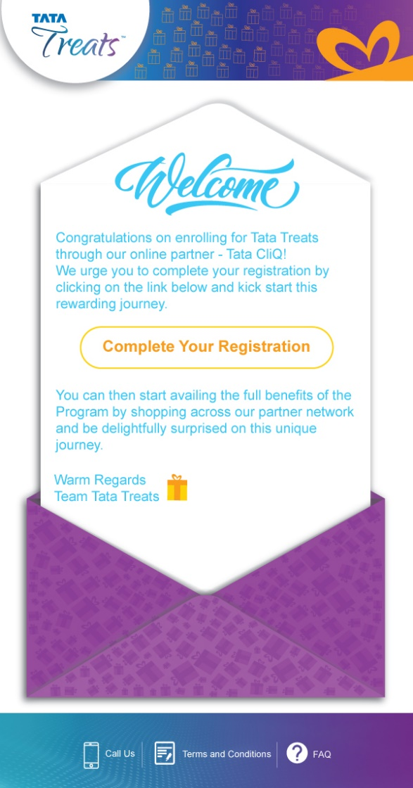
Specific for CliQ Enrolees
Welcome e-mailer for 50k CliQ registered members
Special Gift for 100 first registrations
Members who have not yet joined. First cuts, more extensive dialogues

Slide 44
Website Demo
Tata Treats Website Demo Link

Slide 45
Point Value
High
General Observations
More the premium-ness of the product/service, higher the value of a point
Large member base, coalition programs with relatively low value purchases have point value in the range Rs.0.25- Rs.0.3
Tata Companies have point values >= Re.1
Inner
Circle
Amex
Encircle
Citibank
Rewards
Tata Treats
Club-west
Product/Service Premium-ness
Shoppers
Stop
Corporation
Bank
Payback
Tata Treats Positioning
Large Member base
Mix of high and mid value products
Transacting with multiple Tata Companies
Ideal Point Value: In between Re. 1 and Rs.0.25; Chosen as Rs. 0.5
Star-
bazaar
Low
0
0.5
1+
Value of a Point (INR)
Non-Tata Co.
Tata Co.
Size of the Bubble ~ Membership Base

Slide 46
P
Pros and Cons of different Point Values
Parameters | Option I: 1 point = 1 Rupees | Option II : 1 point = 50 paisa | Financial Implication | Advantage of Option II
Customer Perception | Easy to understand by the customer. Remembers the value of point | High gratification as one earns more point for each spend. | Constant Customer Value | Higher points per spend
Bonus Points & Promotions | Awarding less points for bonus/referral as point value is high. People generally expect to get 100-500 Points as bonus | Easier to run bonus point campaigns under the same budget e.g. ‘2x / 3x points’ campaigns can be designed and run more frequently | Yes Outflow is lesser when bonus point campaigns are run | Customer perceives higher earning & redemption potential
Rounding on fractional spend | High rounding loss to customer esp. in smaller transaction size. | Rounding loss is reduced as the amount to be spent to earn a point is lowered | None | All cost of points is borne by partners
Redemption | Easy calculation for the customer- The value of Rs. 1 will be demanded by customer across all places results in lower margin. | Harder for customer to decipher point value- Gives flexibility for to setup differential value at different merchants | Lower margin at redemption with Option 1 | More flexibility for program to reward customer
Note:
The value of the point will not be explicitly communicated to the customer.
Member would be able to calculate when purchasing products with displayed MRPs.
For services like flights and room stays, the calculation will be dynamic and harder to decipher.

Slide 47






Currency Accumulation And Redemption Lifecycle – Case 1
Customer
3
Earn Partner
1
Purchases Goods worth ₹5000
Purchases goods across coalition partners
Coalition Partners
2
Partner gives 250 encircle points
Converts encircle points to Tata Treats Points
Total Tata Treats Points: 1000
4
5
Collects 750 Tata Treats points across coalition partners
8
Receives Rs. 250/- from Titan
7
Provides Air Ticket with
₹ 1000 discount
Redeems 1000 Points Air Ticket Discount
6
Redemption
Tata Treats
10
Gives Rs.1000-Redemption fee to Vistara
9
Receives Rs. 750/- from respective coalition partners
Notes:
Caveats:
Titan is not charged any processing fee on Accrual
Redemption fee is deducted from the redeeming company
Program management fee of 1 lakh is waived off for the first year of the engagement

Slide 48
Currency Accumulation And Redemption Lifecycle – Case 2
Customer
1
Earn Partner
4
Redeems 1000 points on new watch collection
Purchases goods across coalition partners
Coalition Partners
5
Gets Rs. 1000 off on the purchase
Converts Tata Treats points to encircle Points
Total encircle Points: 1000
2
3
Collects 1000 Tata Treats points across coalition partners
7
Gives Rs.1000-Redemption fee to Titan
Loyalty Exchange
Receives Rs. 1000/- from respective coalition partners
6

Slide 49

List of Privileges: Tata Manufactories
Plant Visits (Company) | Location | Frequency/ Year | Batch Size | Cost/ person | Total Cost | Perceived Value | Implementation Probability*
Tata Motors | Pune, Uttarakhand, Lucknow, Jamshedpur | 4 | 10 | 40,000 | 16,00,000 | High | High
Titan | Hosur and Dun | 4 | 10 | 30,000 | 12,00,000 | High | High
Tata Steel | Jamshedpur | 4 | 10 | 40,000 | 16,00,000 | Medium | Medium
Tata Chemicals | Mithapur, Gujarat | 4 | 10 | 50,000 | 20,00,000 | High | Medium
Tata Power | Hydroelectric units near Mumbai | 4 | 10 | 30,000 | 12,00,000 | Low | Low
Tata International | Leather & Shoes, Indore | 4 | 10 | 30,000 | 12,00,000 | Low | Low
TGBL | Tea plantations in Munnar and Assam | 4 | 10 | 50,000 | 20,00,000 | High | Medium
Tata Coffee | Coffee plantations in Coorg, ex-Bangalore | 4 | 10 | 50,000 | 20,00,000 | High | Medium
Taj Group of Hotels | Taj Mahal Palace Hotel, Mumbai | 4 | 10 | 50,000 | 20,00,000 | High | High
Tata Archives Pune | Pune | 4 | 10 | 30,000 | 12,00,000 | Low | High
JLR Plant | UK | 1 | 5 | 2,00,000 | 10,00,000 | High | Low
1
2
3
4
5
6
7
8
9
10
11
Prioritization Formula= Low Cost X High Perceived Value X High Implementation Probability

Slide 50
List of Privileges: Experiences and Events
(Company) | Experience/Event | Location | Batch Size | Cost/ person | Total Cost | Perceived Value | Implementation Probability*
All | Celebrity Events | Pan India | 10 | 10,000 | 1,00,000 | High | Low
TGBL | Coffee tasting at Starbucks | Pan India | 10 | 5,000 | 50,000 | High | High
TCS | TCS Experience Centre + Dine with CEO | Mumbai | 5 | 20,000 | 1,00,000 | High | Low
Tata Motors | Match Passes (IPL) | Pan India | 10 | 5000 | 50,000 | Medium | High
Tata Motors | Auto Expo | Delhi | 10 | 30,000 | 3,00,000 | High | Medium
Tata Motors | Auto Expo | Geneva | 5 | 1,00,000 | 5,00,000 | High | Low
Tata Motors/JLR | Vehicle Launch Invite | Mumbai | 10 | 20,000 | 2,00,000 | High | Low
Tata Motors | Drive with Narayan Karthikeyan | Delhi | 5 | 30,000 | 1,50,000 | High | Medium
Tata Motors | Invite to T1 Prima Tata Motors lounge | Delhi | 10 | 30,000 | 3,00,000 | High | Medium
Tata Motors | Exclusive road trip for select participants | Pan India | 10 | 20,000 | 2,00,000 | Medium | Medium
Tata Motors | Winter Testing at Leh | Leh | 5 | 25,000 | 1,25,000 | High | Low
JLR | Vehicle at Disposal for whole day | Pan India | 1 | 10,000 | 10,000 | Medium | Low
Tata Steel | Tata Steel Adventure Foundation organized Trek | Uttarkashi | 10 | 40,000 | 4,00,000 | High | Medium
Tata Trusts | Week long stay in a Village | Pan India | 6 | 10,000 | 60,000 | Medium | Low
Tata iQ | Donate points and track impact | Pan India | - | - | - | High | High
1
2
3
4
5
6
7
8
9
10
11
12
13
14
15

Slide 51
List of Privileges: Treats and Goodies
(Company) | Experience/Event | Number/ Year | Cost/ person | Total Cost | Perceived Value | Implementation Probability*
Tata Motors | Free custom kit for your Tata vehicle | 12 | 10,000 | 2,40,000 | Low | Medium
Tata Steel | Ingot replica with Chairman’s signature | 4 | 10,000 | 40,000 | High | Medium
Tata Communication | Excusive F1 team Merchandise | 4 | 10,000 | 40,000 | High | Low
Tata Chemicals | Year’s supply of Tata Salt or a free Tata Swach | 12 | 10,000 | 1,20,000 | Medium | Low
Tata Teleservices | Premium Tata Docomo Photon service for a month | 12 | 2,000 | 24,000 | Low | Low
Tata Teleservices | A free end-to-end internet setup for your home | 12 | 2,000 | 24,000 | Low | Low
Titan | Custom watch / limited edition / FT personalized kit | 4 | 5,000 | 20,000 | High | Medium
Tata Sons | Tata Group Memento/ Memoribilia | 4 | 5,000 | 20,000 | Low | Medium
Titan | Wedding special discount/custom jewellery | 4 | 10,000 | 40,000 | High | Medium
TGBL | Year’s supply of tea / coffee | 12 | 12,000 | 1,44,000 | Medium | Low
IHCL | A day at the Presidential suite- exclusive table for 2 | 4 | 20,000 | 80,000 | High | High
Tata Sky | Free Tata Sky HD subscription for 6 months | 4 | 6,000 | 24,000 | Medium | Low
Croma | Freebies / discount voucher | 12 | 5,000 | 60,000 | Low | High
Vistara | Free upgrade for every ticket you buy + Pick n Drop | 12 | 10,000 | 1,20,000 | High | High
Tata CliQ | Surprise gift from Unistore, delivered home | 12 | 5,000 | 60,000 | Low | High
Tata iQ | Double the Points on Lifestages/Special Occassions | - | 100 | - | High | High
1
2
3
4
5
6
7
8
9
10
11
12
13
14
15
16

Slide 52
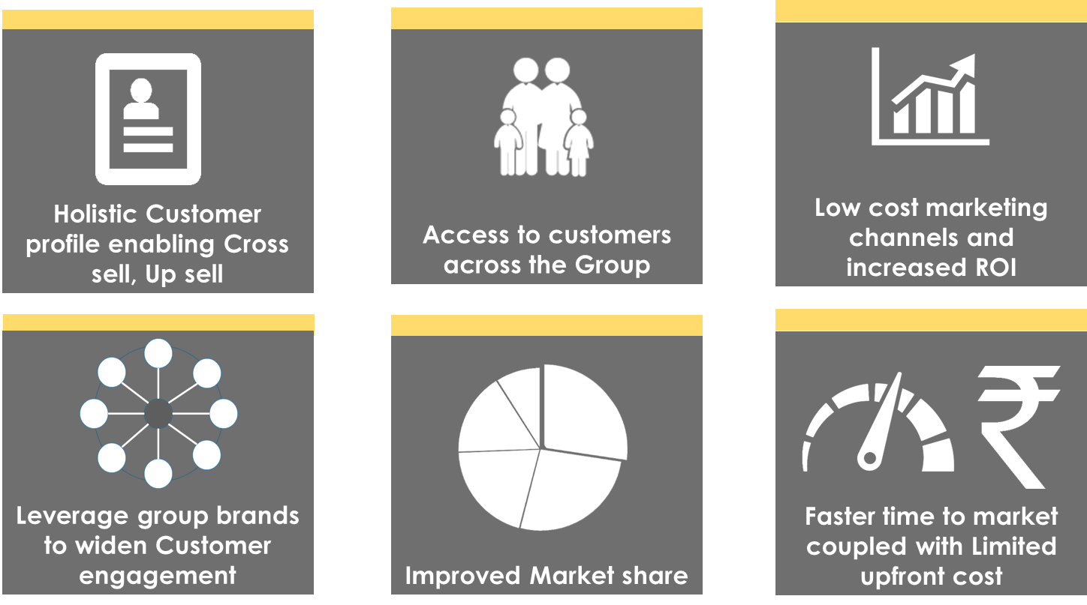
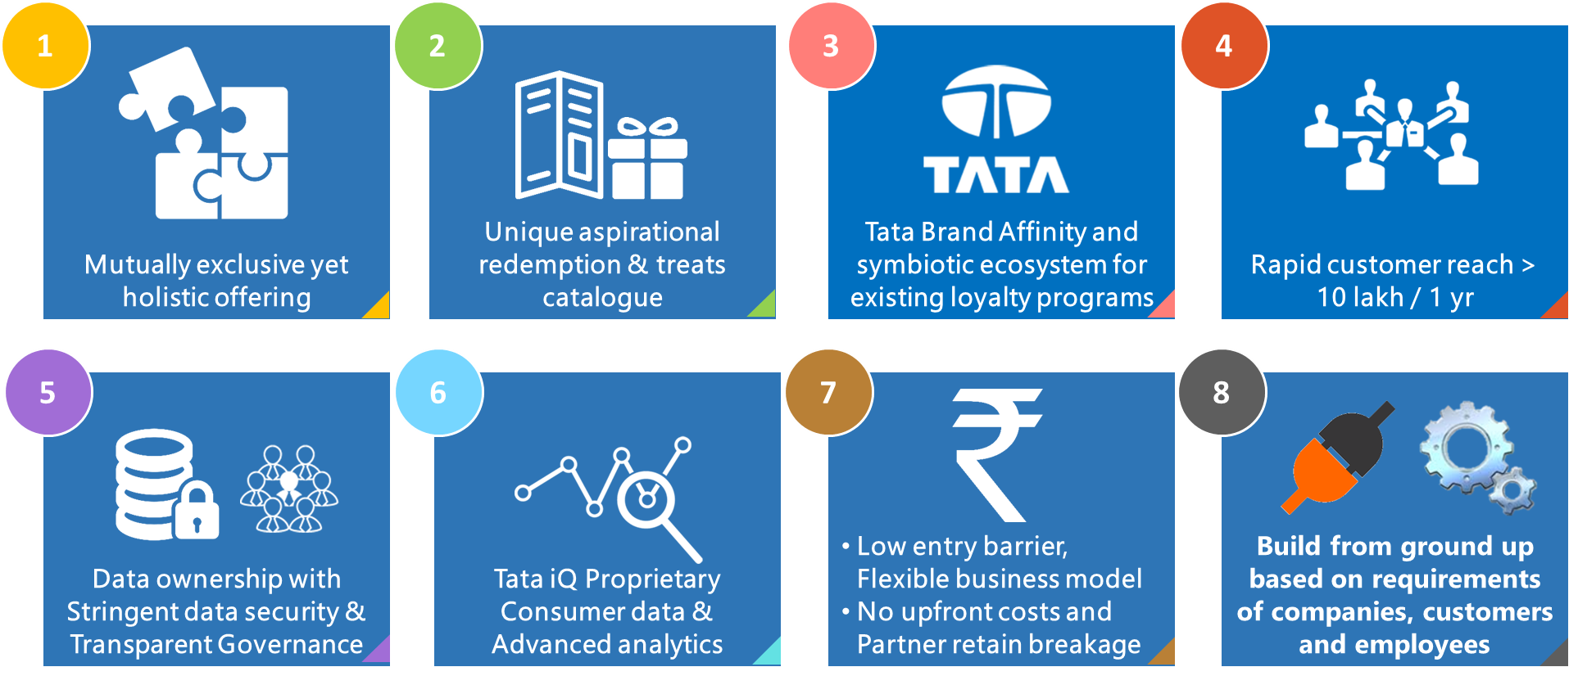

Why Join Tata Treats…
Ubiquity of the program Greater engagement, Stickiness and Responsiveness
Improved Business Results
Coalition programs offering both Push-Pull to acquire, engage, and retain customers
Differentiators - Compared with other coalition programs and learning from Empower & Tata Card
Robust Processes to manage Loyalty operations and Services
Tata iQ Proprietary Consumer data and Advanced analytics
Loyalty platform and Infrastructure coupled with stringent data security & Transparent Governance

Slide 53
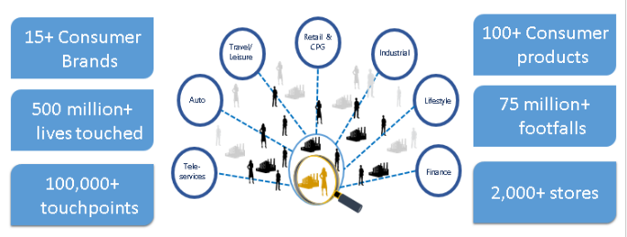
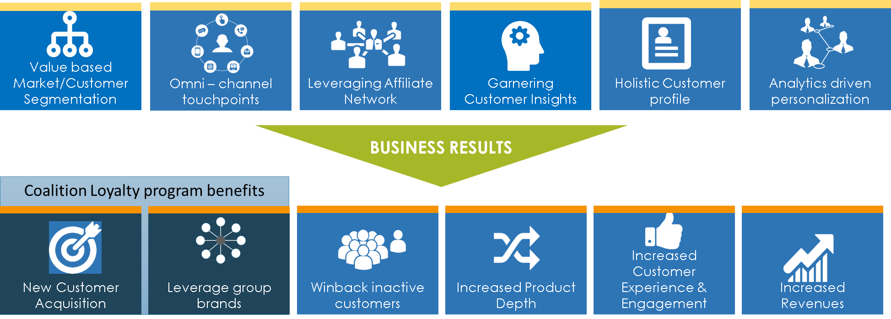
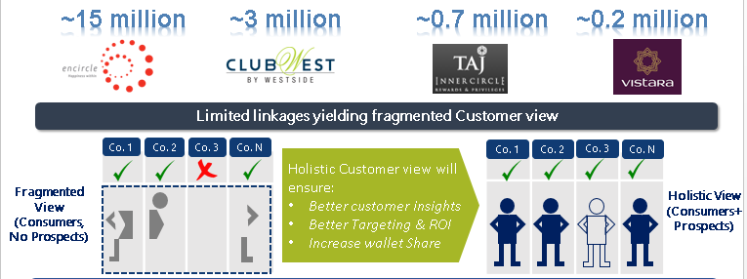
Tata Treats – a Key enabler to Customer Centricity
TATA Group has one of the largest consumer connect ; still we have limited cross-linkage
Tata Treats – a key Enabler to customer centricity
Powered by insights for Value-based segmented and omni-channel marketing actions
Opportunity exist to deepen consumer engagement
Only 1 of 5 consumers engage through a loyalty program
Siloed view of customer across the group
Brands with No Loyalty Program today
Brands with Loyalty Program today

